Slide 1
Power BI Dashboards

Slide 2
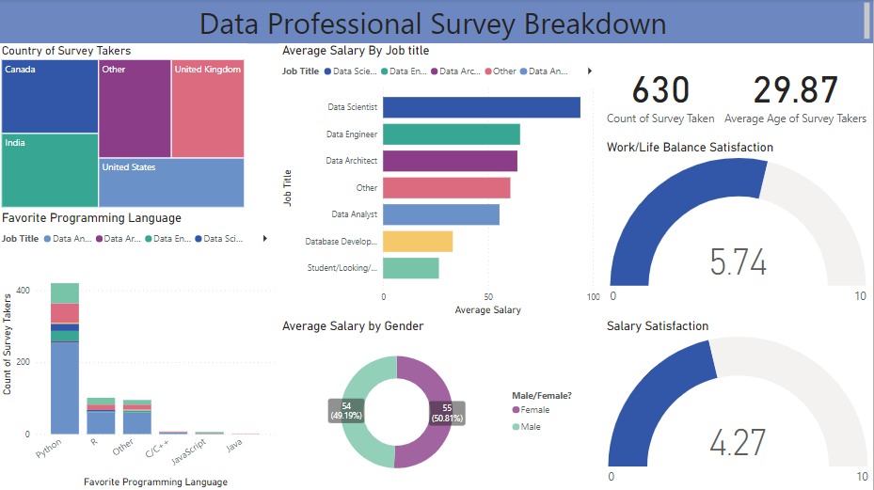

Slide 3
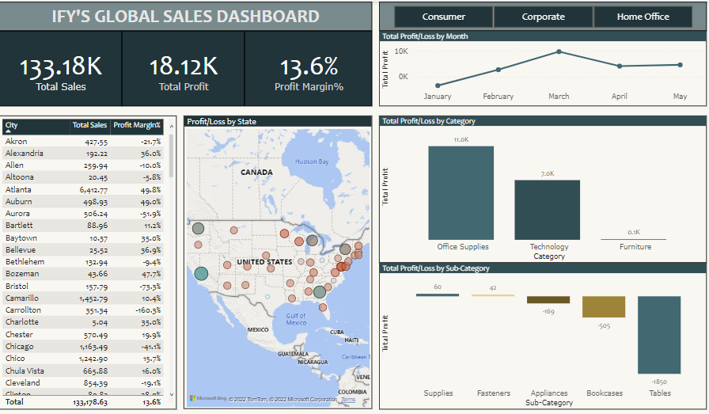

Slide 4
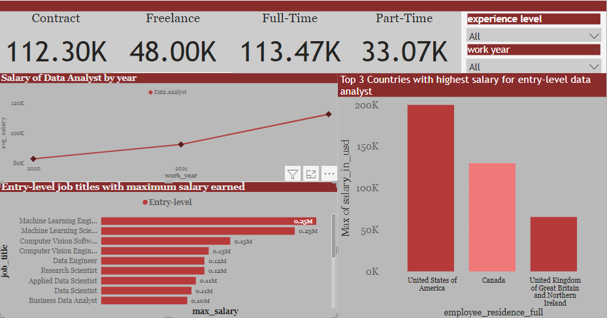

Slide 5
Excel Dashboards

Slide 6
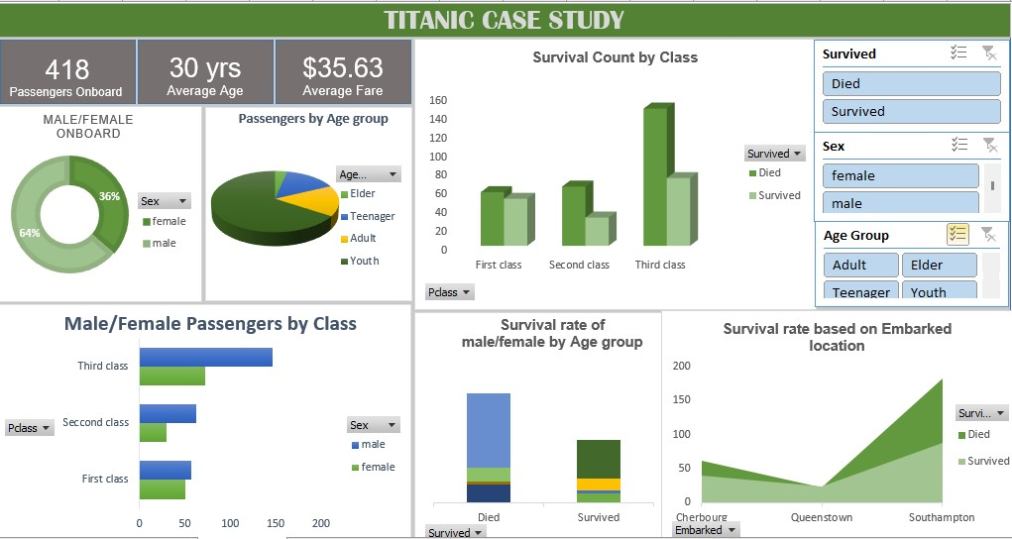

Slide 7
